Slide 1

LHL – CAPSTONE FFXIV Consumables Market Analysis
By Theo Plessas

Slide 2
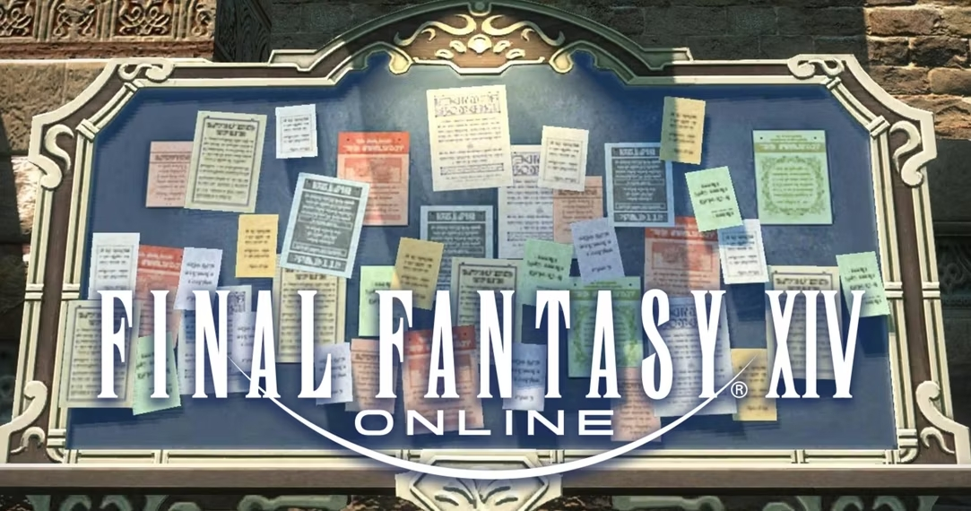
What is the Market Board?
Central hub for Players to buy and sell items from other Players
Pricing is fully Player-Driven
Market-Trends and Fluctuations exist
Hard to predict since Player needs are evolving
Different Players fill different supplier roles
Raw material
Intermediate ingredient
Crafted item

Slide 3





Why Consumables?
Used in challenging content to enhance Player power
Players organize themselves weekly for this content
It’s the part of the market I participate the most in
The Goal !
To identify any market patterns in 5 high-end items to maximize my profits
Which days during the week are most Players buying these 5 items?
Can I build a predictive model for these items?

Slide 4


Tools & API
Universalis – Universalis is a market board data site with crowd sourced information
XIVAPI – Provides a massive amount of FINAL FANTASY XIV game data in a JSON format via a REST API

Slide 5
The Data
53 weeks of Data
We are looking at 5 different potions – They all effect different Player stats
Strength - 173300 Transactions
1 outlier
Dexterity – 74692 Transactions
1473 outliers
Mind – 73726 Transactions
282 outliers
Intelligence – 64938 Transactions
1063 outliers
Vitality – 770 Transactions
25 outliers

Slide 6
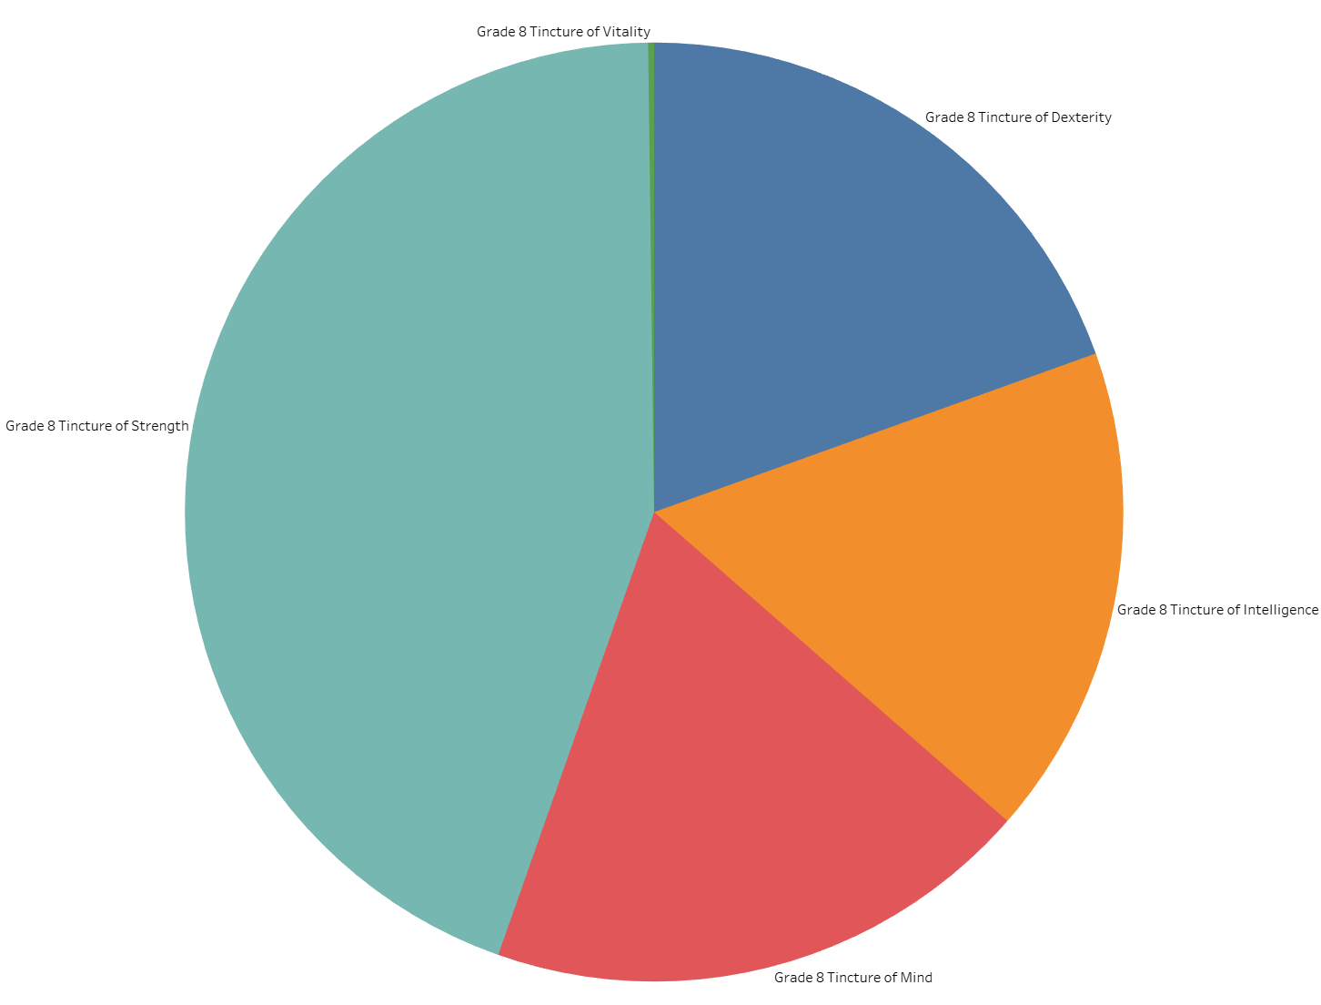
Market Composition

Slide 7
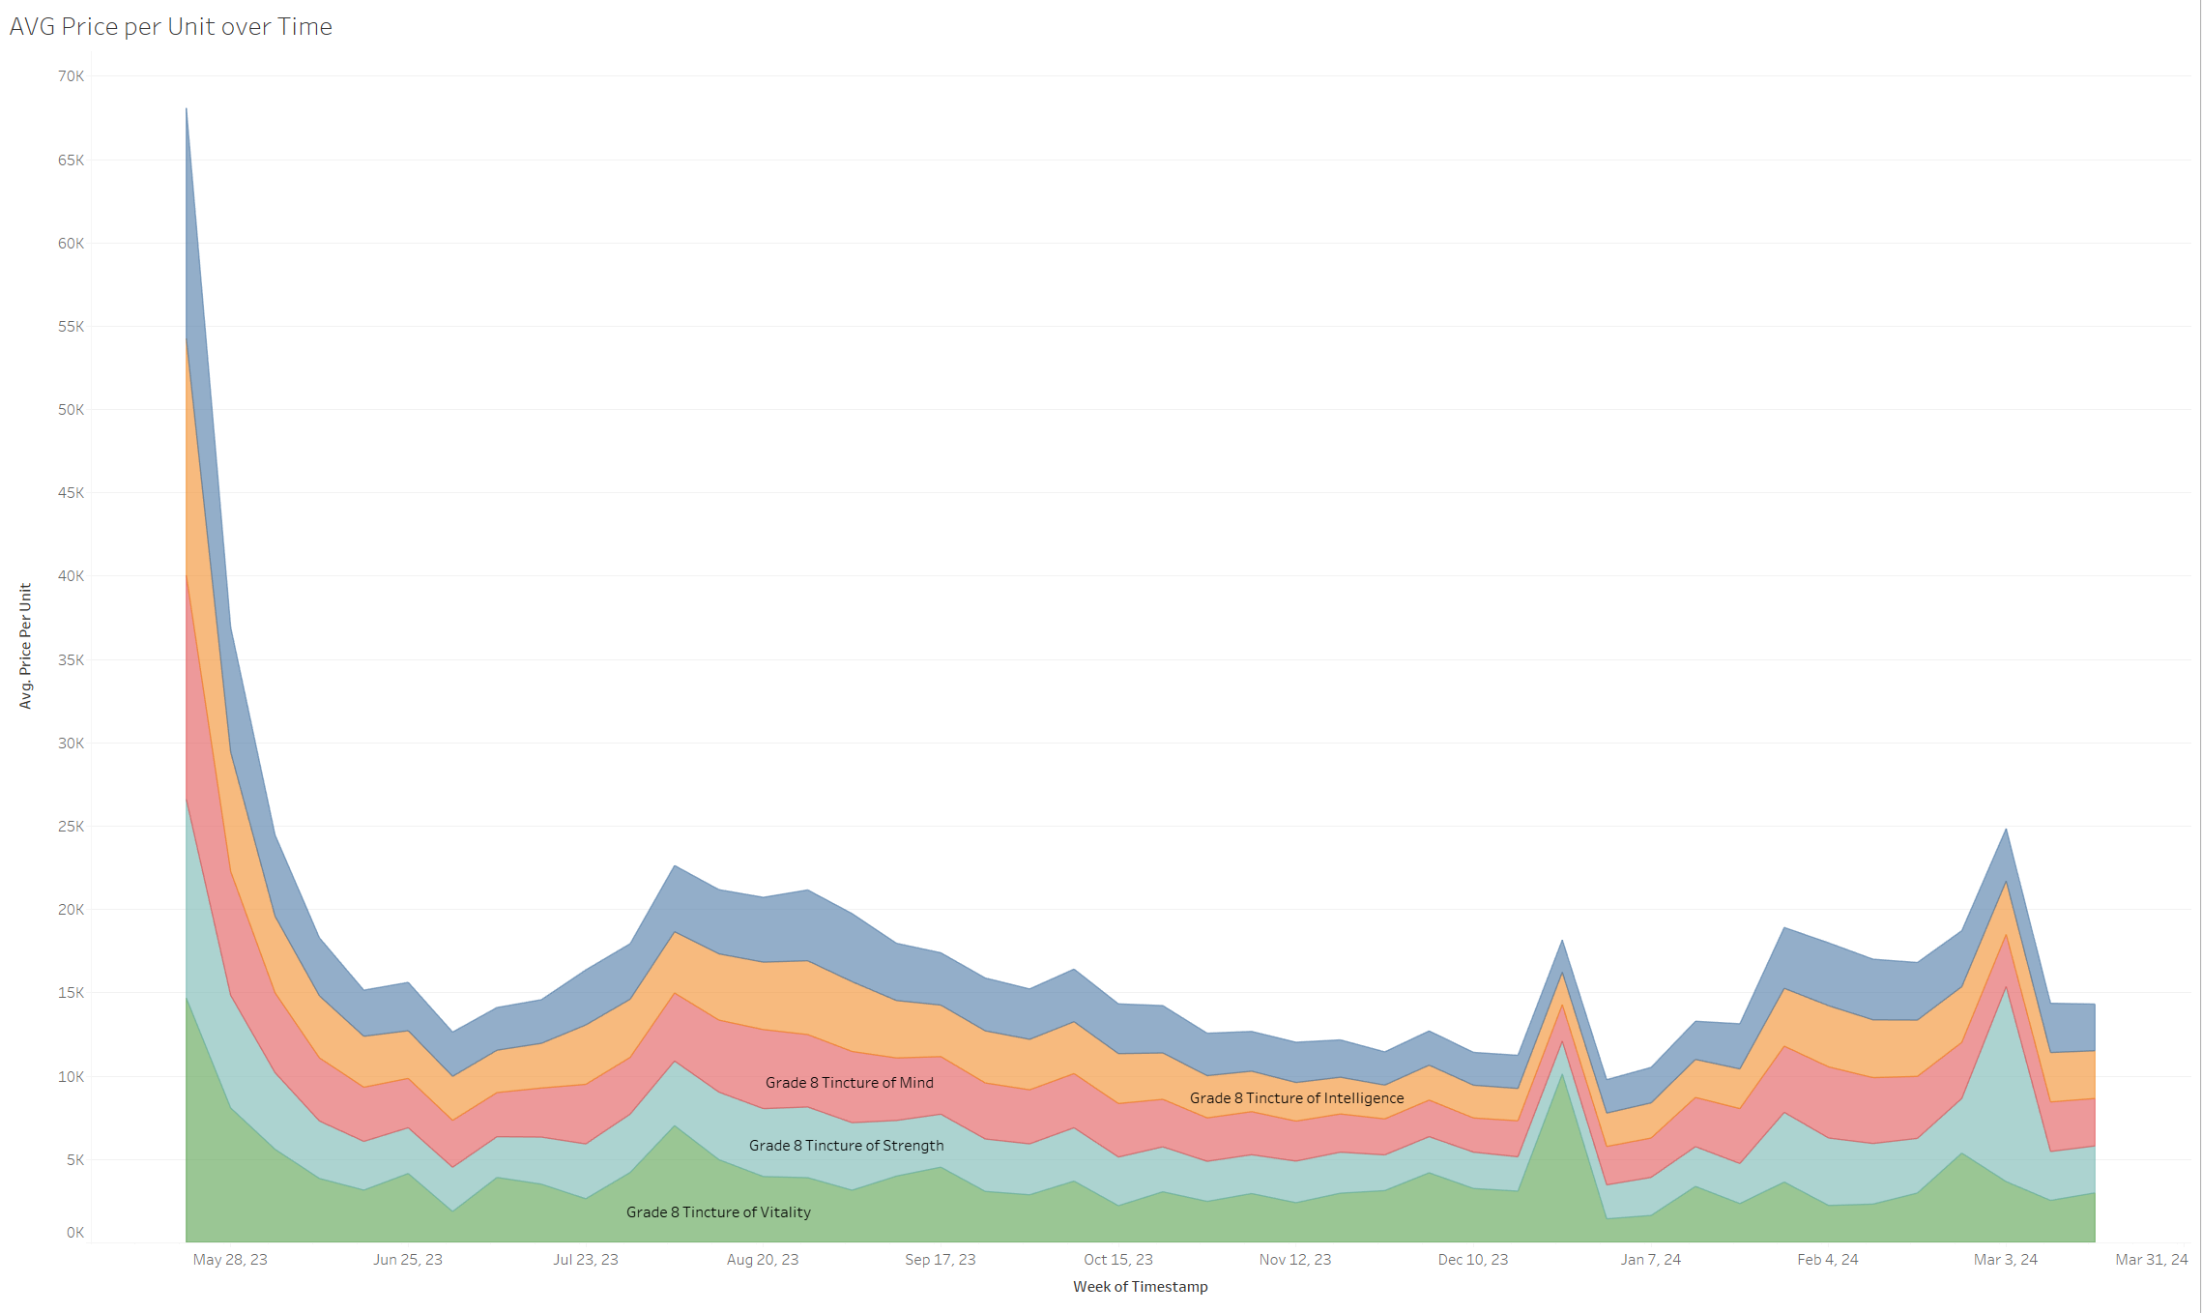
Avg Price per unit by Week

Slide 8
Forecasting

